Slide 1
KDA VALIDATION
Eric Zhuang 8/10/2026

Slide 2
Post-KDA Analysis Outline:
Identify recurring drivers
Compare these genes across cell-type networks to mitochondrial + OXPHOS
Test these results across sex-APOE group

Slide 3
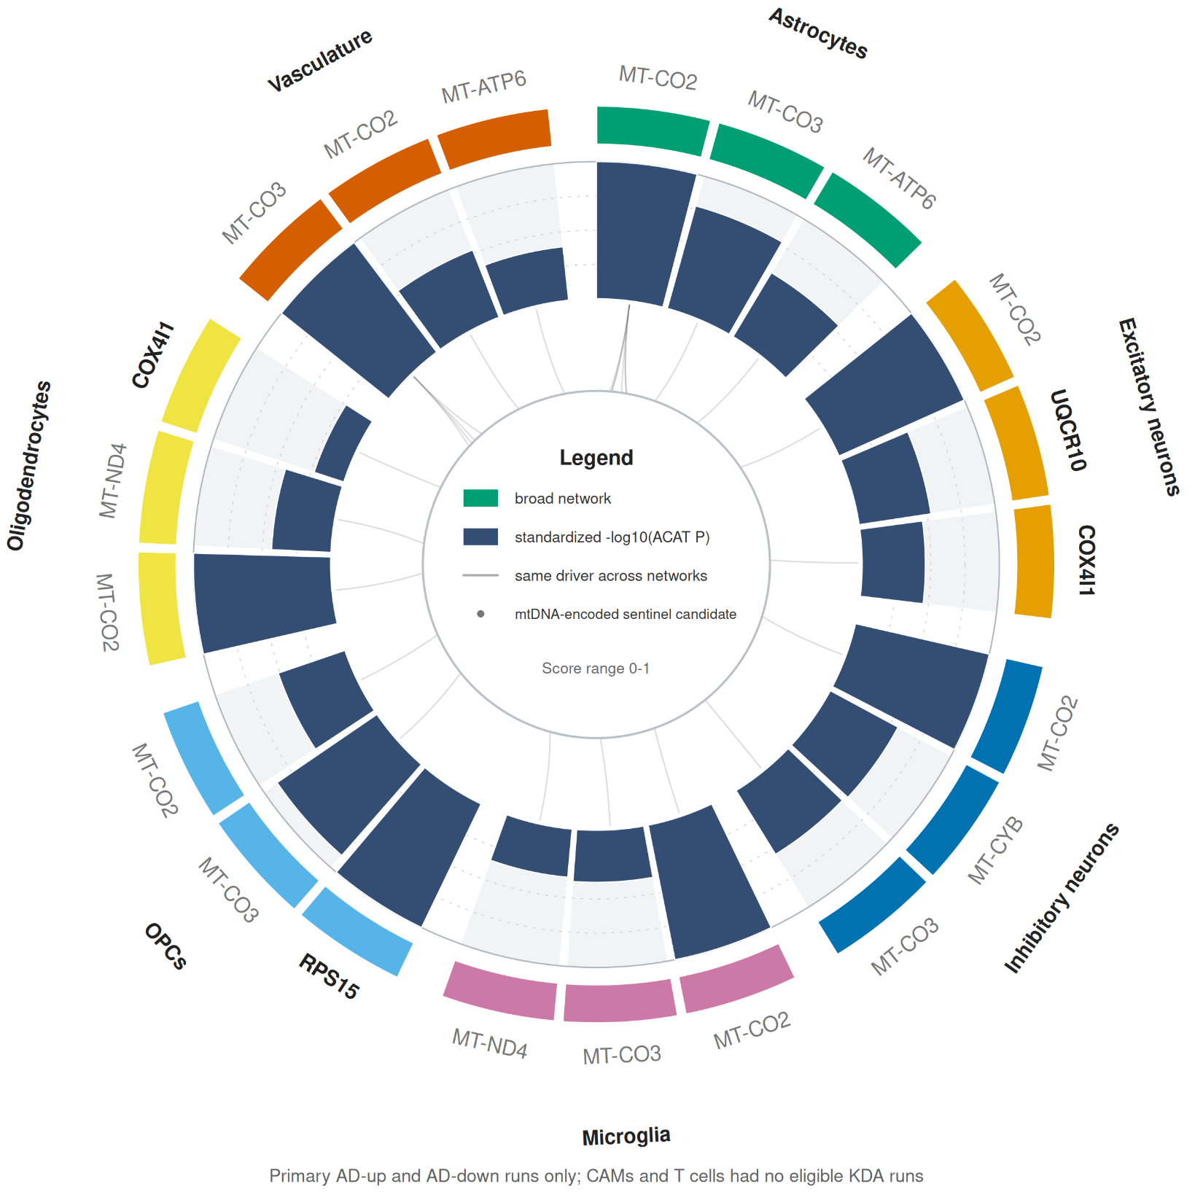
Revised Circular Figure
Recurrent mitochondrial KDA evidence across brain cell networks
Top 3 coverage-qualified drivers per network, ranked by combined ACAT P

Slide 4
Revised Circular Figure (Setup)
7 eligible broad cell type networks
3 drivers per network, ranked by ACAT p-value
Central links represent shared drivers across networks
Notes:
Mean −log10(PKDA) across eligible runs

Slide 5
Revised Circular Figure (Conclusions)
10 unique genes identified
17/21 sectors are mtDNA
MT-CO2 appears in 6 broad-cell types
MT-CO3, MT-ATP6, MT-CYB, and MT-ND4 appear often as well

Slide 6
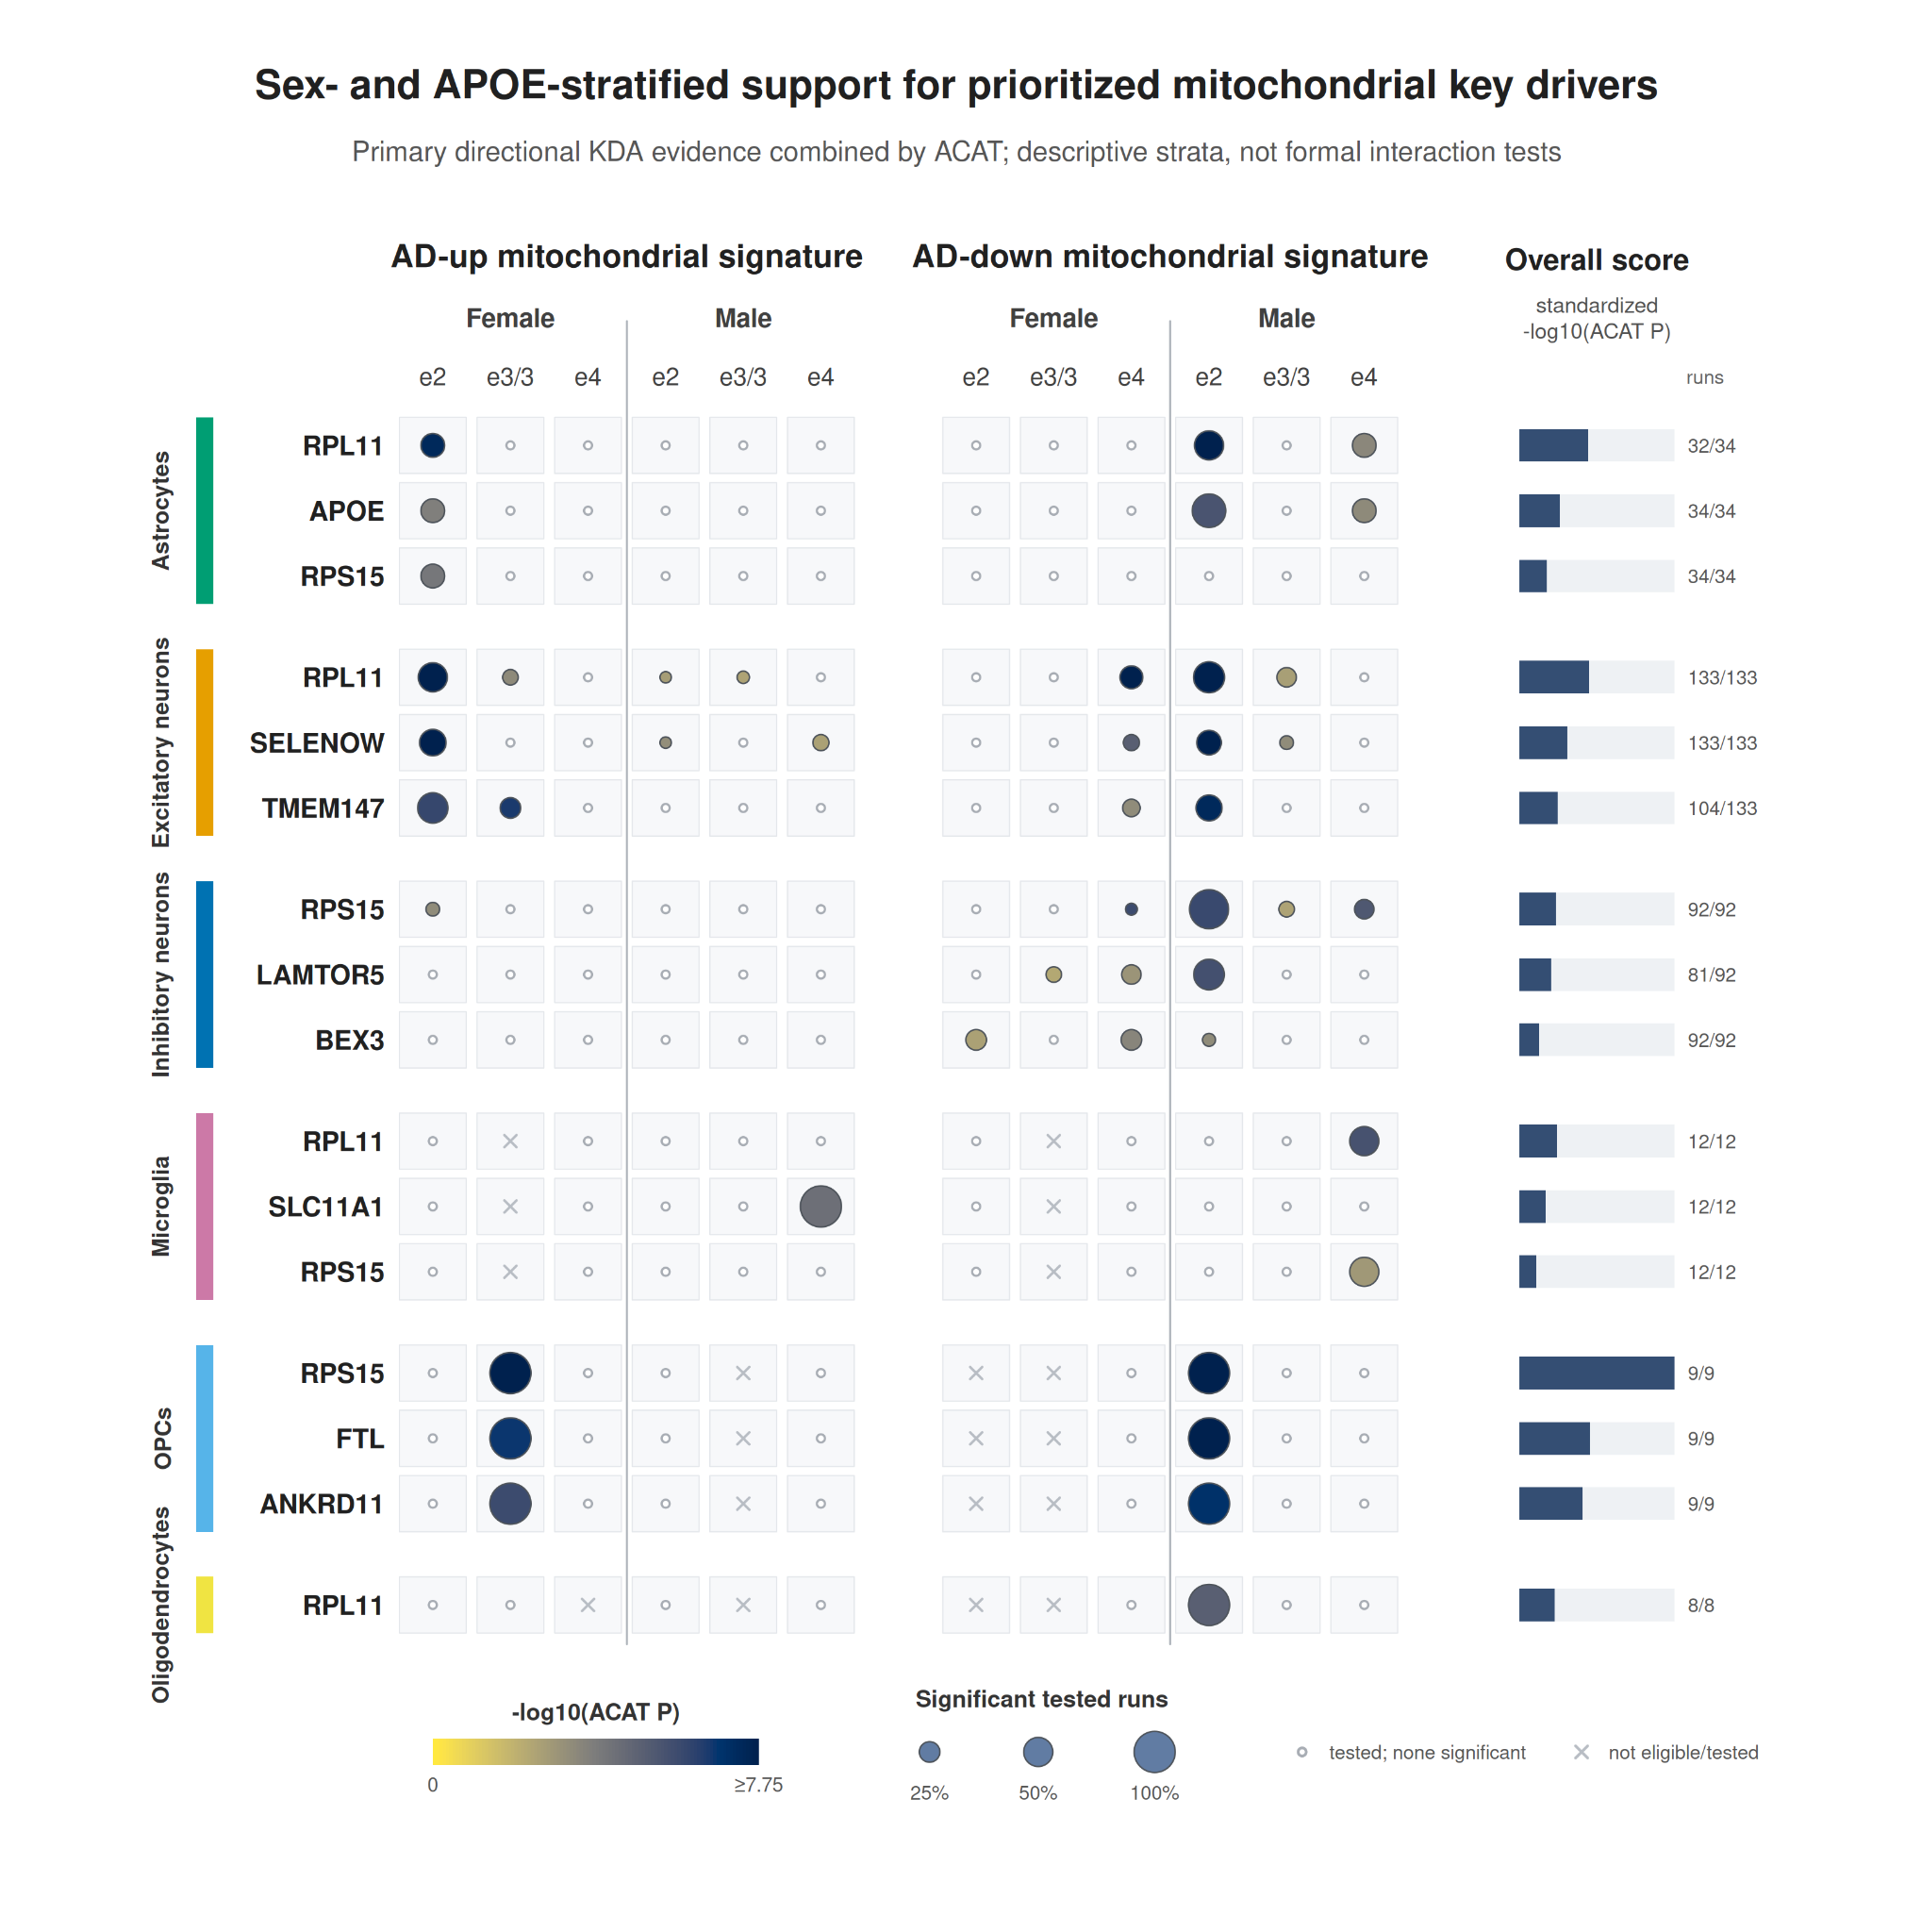
Sex-APOE Validation (Setup)
Notes:
Size = proportion of runs significant
Color = mean log P value, dark blue is best

Slide 7
Sex-APOE Validation (Conclusions)
Female ε2: Support upregulation in significant runs across astrocyte and excitatory neurons
Male ε2: Support downregulation in 4 cell types

Slide 8
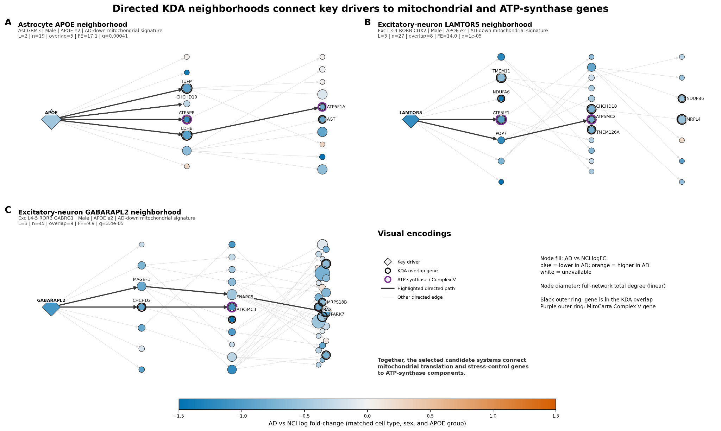
Bayesian Network Analysis on KDA Conclusions
Notes:
Illustration of KDA connections relevant to understanding the three main conclusions from last week, in the relevant cell type.

Slide 9
Bayesian Network Analysis on KDA Conclusions
Notes:
Illustration of KDA connections relevant to understanding the three main conclusions from last week, in the relevant cell type.

Slide 10
Bayesian Network Analysis (interpretation)
APOE, astrocytes:
Direct network regulation of TUFM and ATP5PB
Indirect regulation of ATP5F1A via LDHB
LAMTOR5, exc. Neuron
Connected to ATP5IF1
Connected to ATP5MC2 via POP7

Slide 11
Bayesian Network Analysis on KDA Conclusions
Notes:
Illustration of KDA connections relevant to understanding the three main conclusions from last week, in the relevant cell type.

Slide 12
Bayesian Network Analysis (interpretation)
GABARAPL2, excitatory:
Regulates, CHCHD2 which controls ATP5MC3;
Regulates PARK7 via MAGEF1/SNAPC5
Results identify genes for analysis

Slide 13
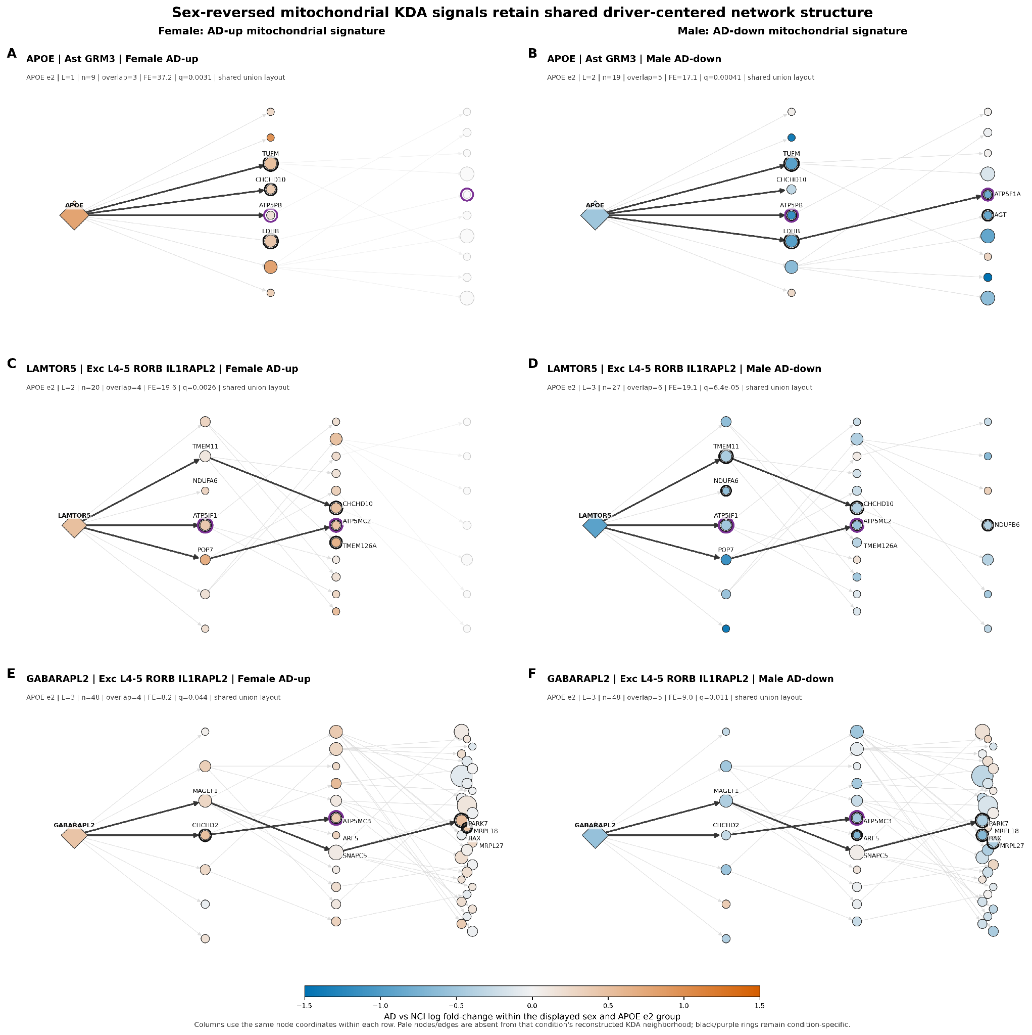
Sex-reversal analysis
Compared the three networks across male ε2 AD-down and female ε2 AD-up
Notes:
Add link

Slide 14
Sex-reversal analysis
Notes:
Add link

Slide 15
Sex-reversal analysis
Notes:
Add link

Slide 16
ATP Synthase Regulation
Nuclear genes that affect ATP in at least 2 directional runs
Findings:
27 direct relationships exist satisfying these criteria

Slide 17
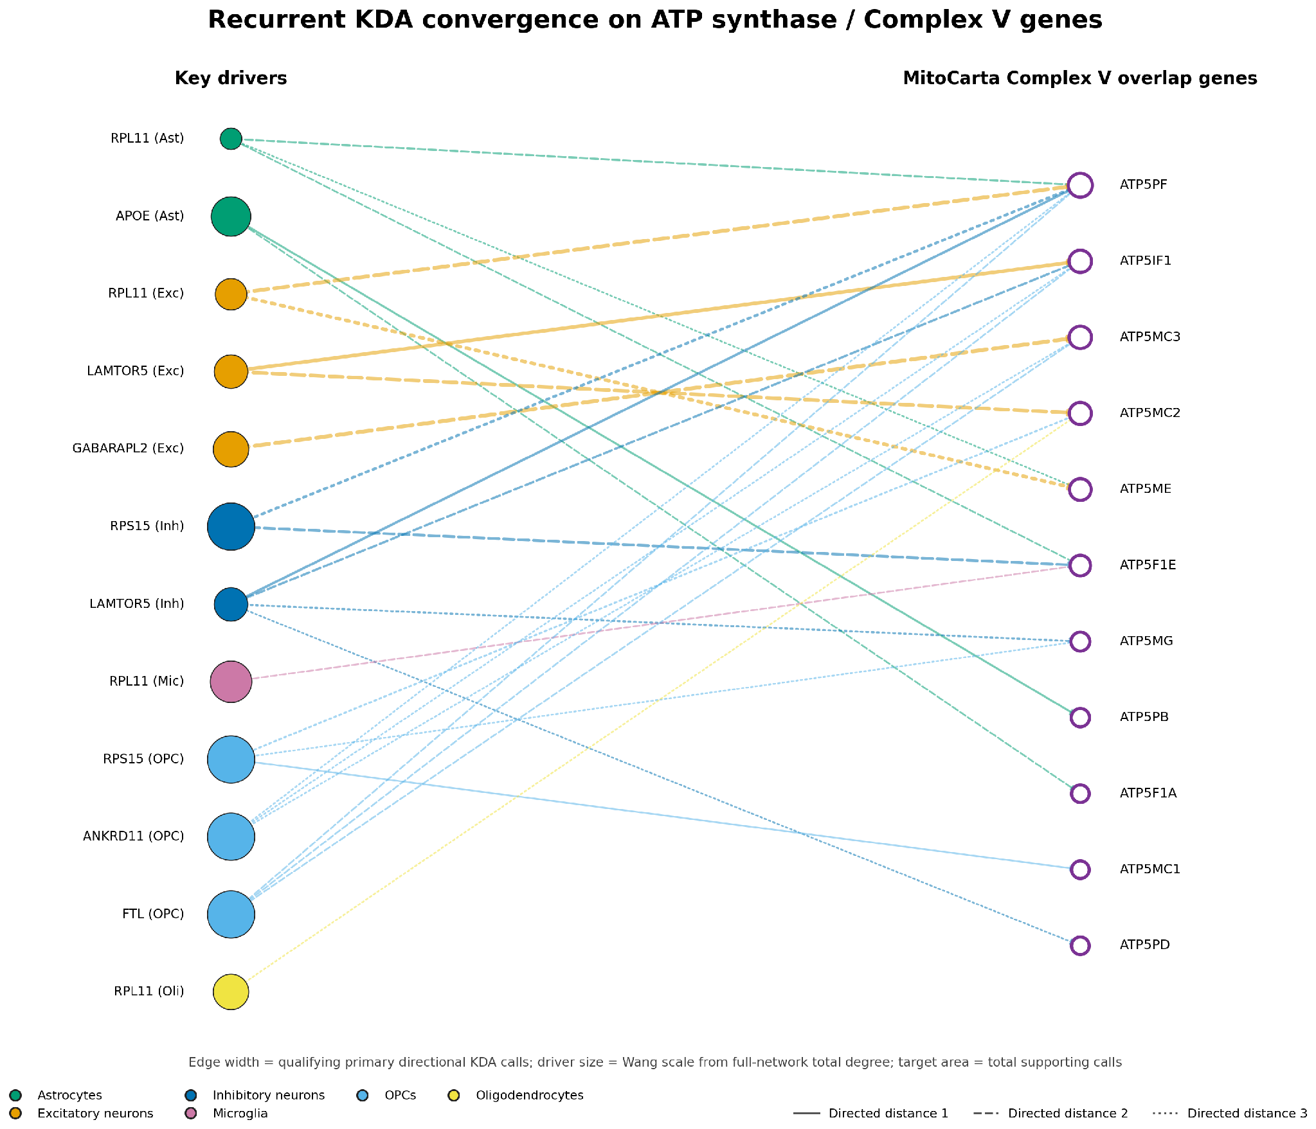
ATP Regulation Map

Slide 18
ATP Regulation Map

Slide 19
ATP Regulation Map

Slide 20
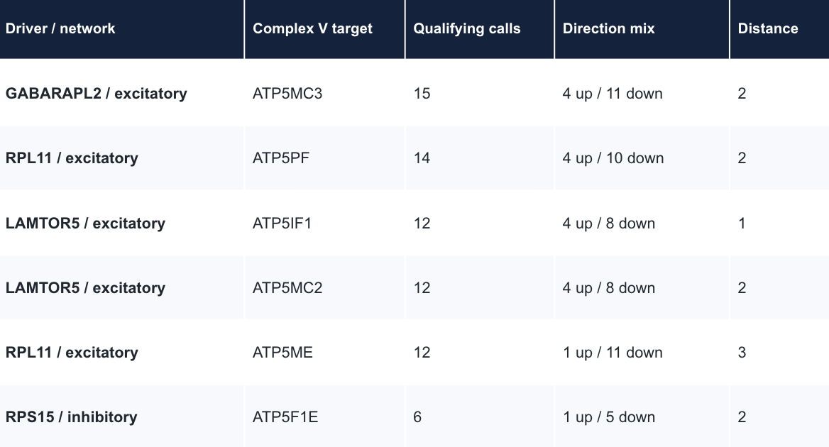
ATP Regulation Map
Nuclear genes that affect ATP in at least 2 primary runs
Findings: 27 direct relationships exist satisfying these criteria

Slide 21
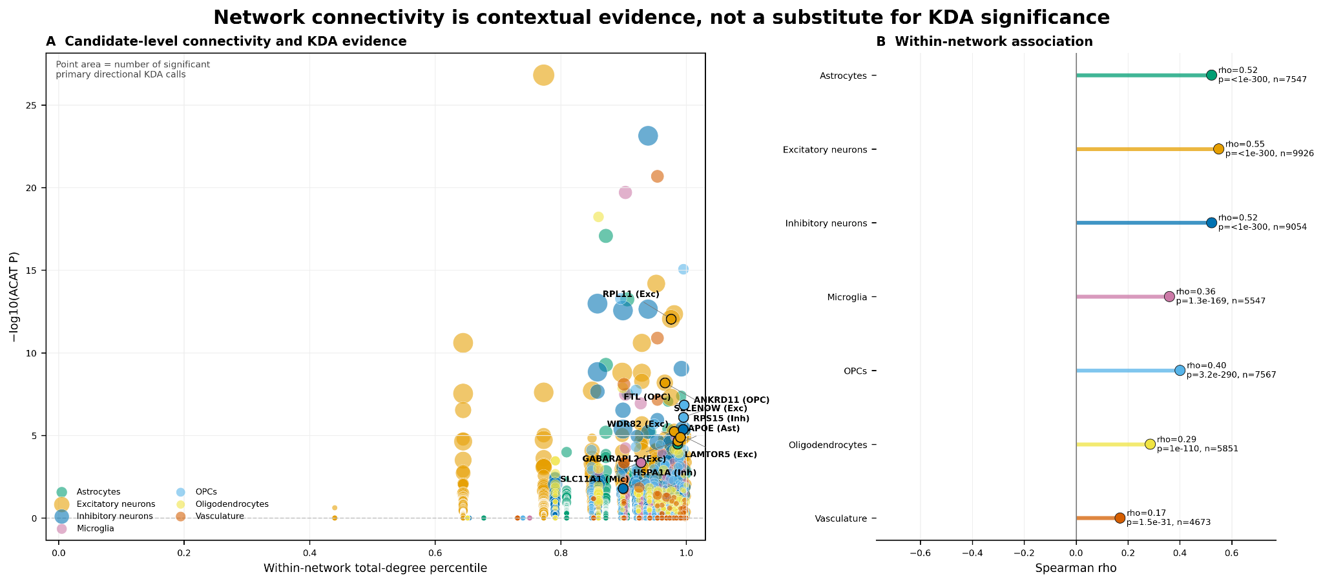
Network Connectivity (Graph)
Notes:
Size represents number of primary directional calls

Slide 22
Network Connectivity (setup)
50,165 records
As connectivity depends on the network, genes may appear multiple times
Spearman correlation calculated on both

Slide 23
Additional Results
APOE, LAMTOR5, and GABARAPL2 have directed routes to OXPHOS and mitochondrial stress/translation genes.
The same drivers/framework connects to female ε2 AD-up and male ε2 AD-down expression
Highest associations occur in excitatory neurons (ρ=0.559) and astrocyte/inhibitory networks (ρ≈0.525). Lowest occur in vasculature.
Notes:
Size represents number of primary directional calls

Slide 24
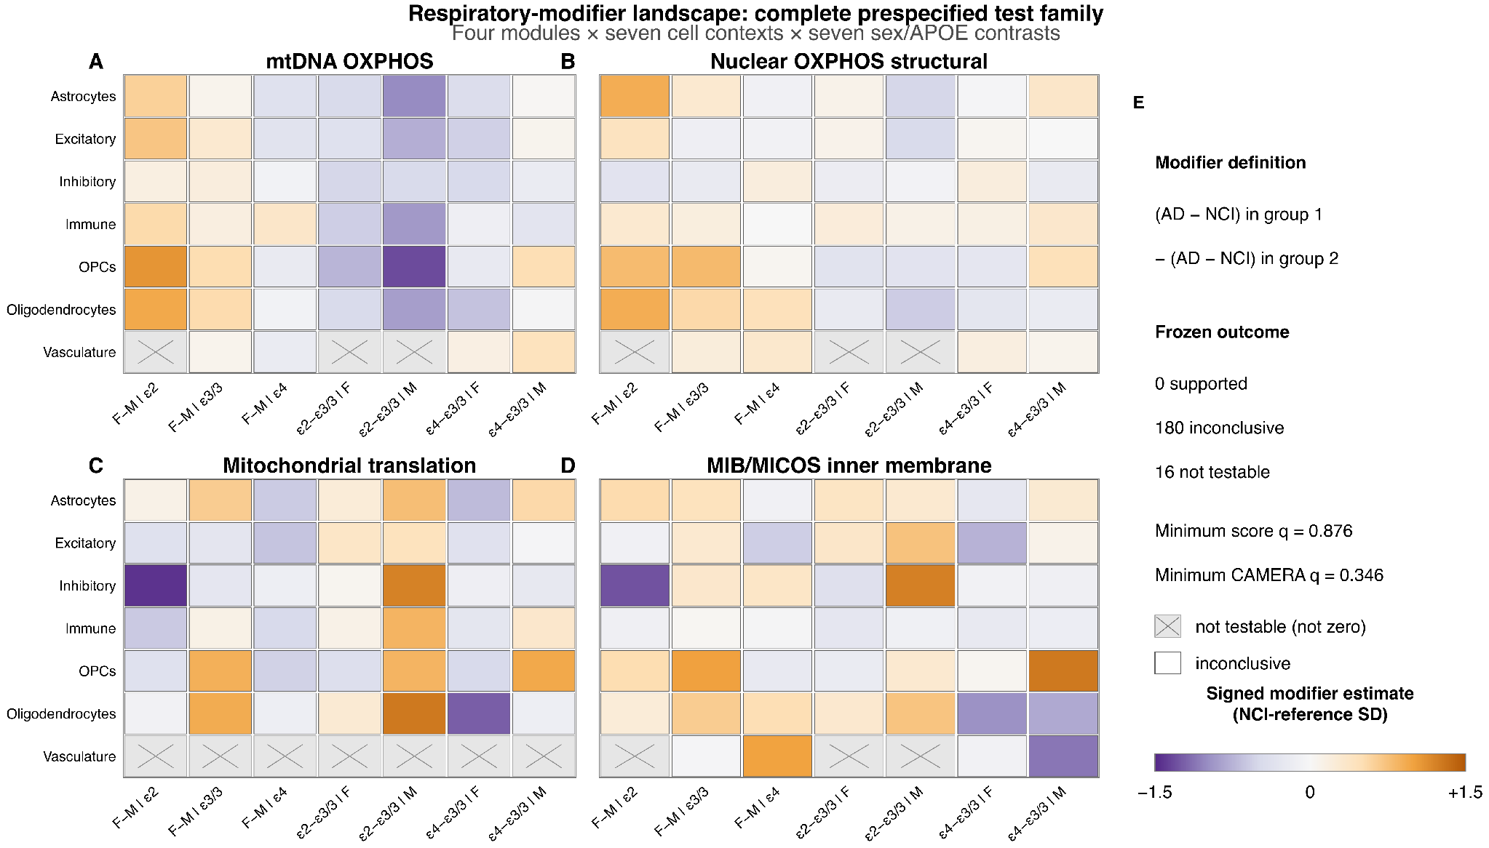
Modifier landscape

Slide 25
Modifier landscape

Slide 26
Modifier landscape (findings)
Color represents similarity between DEGs
Modules did not pass FDR test; thus further validation is required
Some results are untestable; all of these happen in vascular cells

Slide 27
Thank you :)

